Slide 1
程式設計實習
2025.2.21

Slide 2
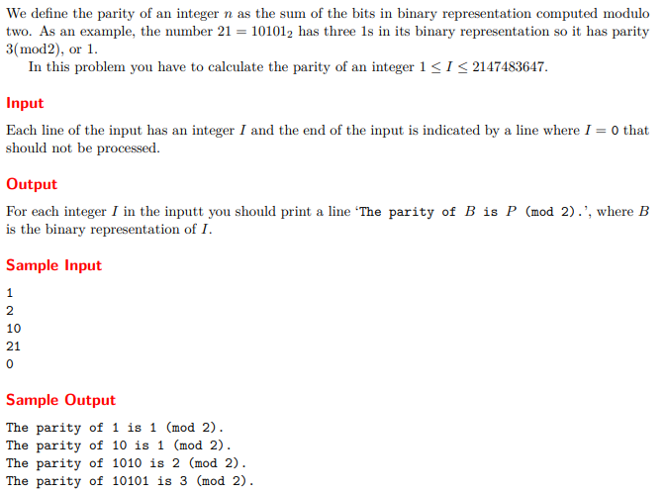
2³¹-1

Slide 3
#include <iostream>
#include <vector>
using namespace std;
int main() {
int input;
vector<int> s;
while (cin >> input && input) {
cout << "The parity of " ;
int count = 0;
s.clear();
while(input != 0) {
s.push_back(input % 2);
if (input % 2) count++;
input /= 2;
}
for (int i=s.size() - 1; i >= 0; i--)
cout << s[i];
cout << " is " << count << " (mod 2)." << endl;
}
return 0;
}
1
The parity of 1 is 1 (mod 2).
2
The parity of 10 is 1 (mod 2).
10
The parity of 1010 is 2 (mod 2).
21
The parity of 10101 is 3 (mod 2).
0

Slide 4
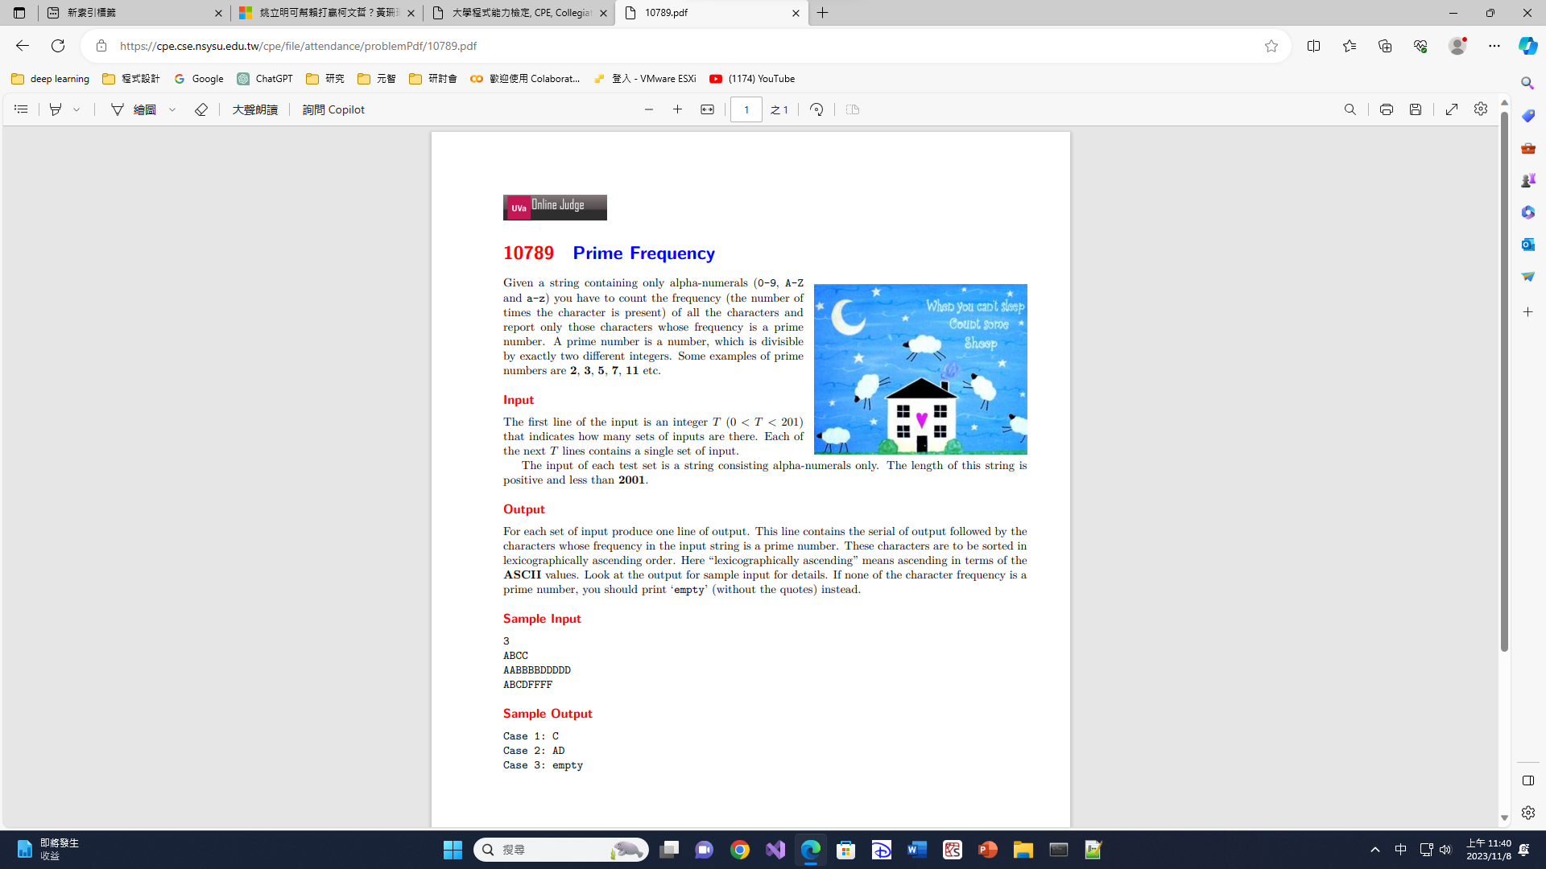

Slide 5
#include <iostream>
#include <set>
#include <vector>
using namespace std;
void mkprime(vector<bool>& prime) {
prime[0] = false;
prime[1] = false;
for (int i = 2; i < 2001; i++) {
if (prime[i]) {
for (int j = i + i; j < 2001; j += i) {
prime[j] = false;
}
}
}
}
int main() {
int T = 0;
vector<bool> prime(2001, true);
mkprime(prime);
cin >> T;
for (int i = 0; i < T; i++) {
string input = "";
set<char> output;
vector<int> count(123, 0); //generate a vector of size int(“z”+ 1) = 123 with each value 0
cin >> input;
for (auto c : input) {
count[c]++;
}
for (int j = 0; j < count.size(); j++) {
if (prime[count[j]]) {
output.insert(j);
}
}
cout << "Case " << i + 1 << ": ";
if (output.empty()) {
cout << "empty" << endl;
}
else {
for (auto j : output) cout << j;
cout << endl;
}
}
return 0;
}
3
ABCC
AABBBBDDDDD
ABCDFFFF
Case 1: C
Case 2: AD
Case 3: empty
2
tTTkkKKKPpP
yyYYRR
Case 1: KPTk
Case 2: RYy
#include <iostream>
#include <vector>
using namespace std;
int main() {
  vector<int>vec = { 4,3,2,1,0 };
  for (auto iter : vec) {
  cout << iter << endl;
  }
  return 0;
}
1
1022AABBCDDDBCACADBDDB
4
3
2
1
0
Case 1: 2BC

